Slide 1
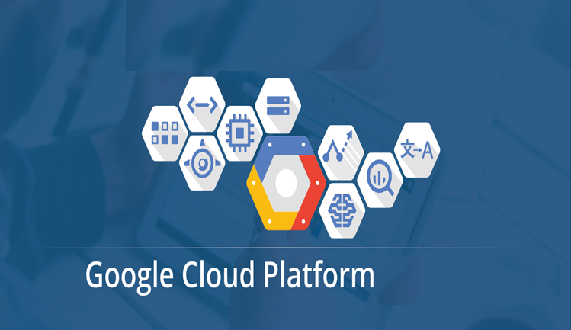

Slide 2

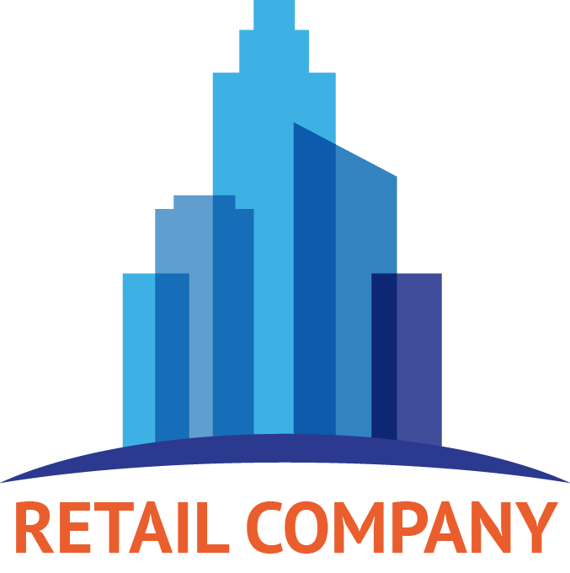
Traditional E-commerce Scenario

Slide 3
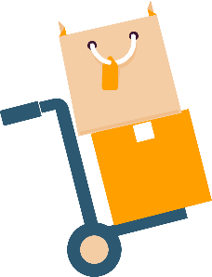
Traditional E-commerce Scenario

Slide 4

Traditional E-commerce Scenario

Slide 5

Traditional E-commerce Scenario

Slide 6

Traditional E-commerce Scenario

Slide 7

Traditional E-commerce Scenario
Increased Website
Traffic

Slide 8

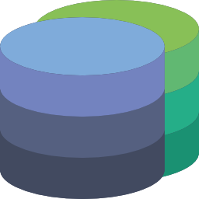
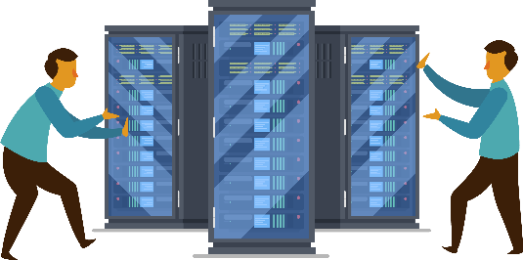




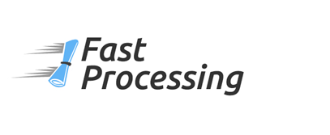

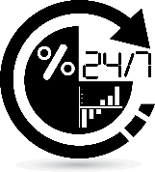

Problems Faced
Database & Security
Managing Servers
Increasing Cost
Scalability Issue
Fast & Fault Tolerant

Slide 9
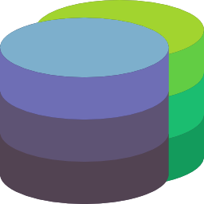
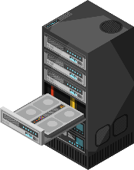
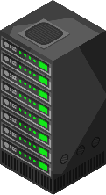

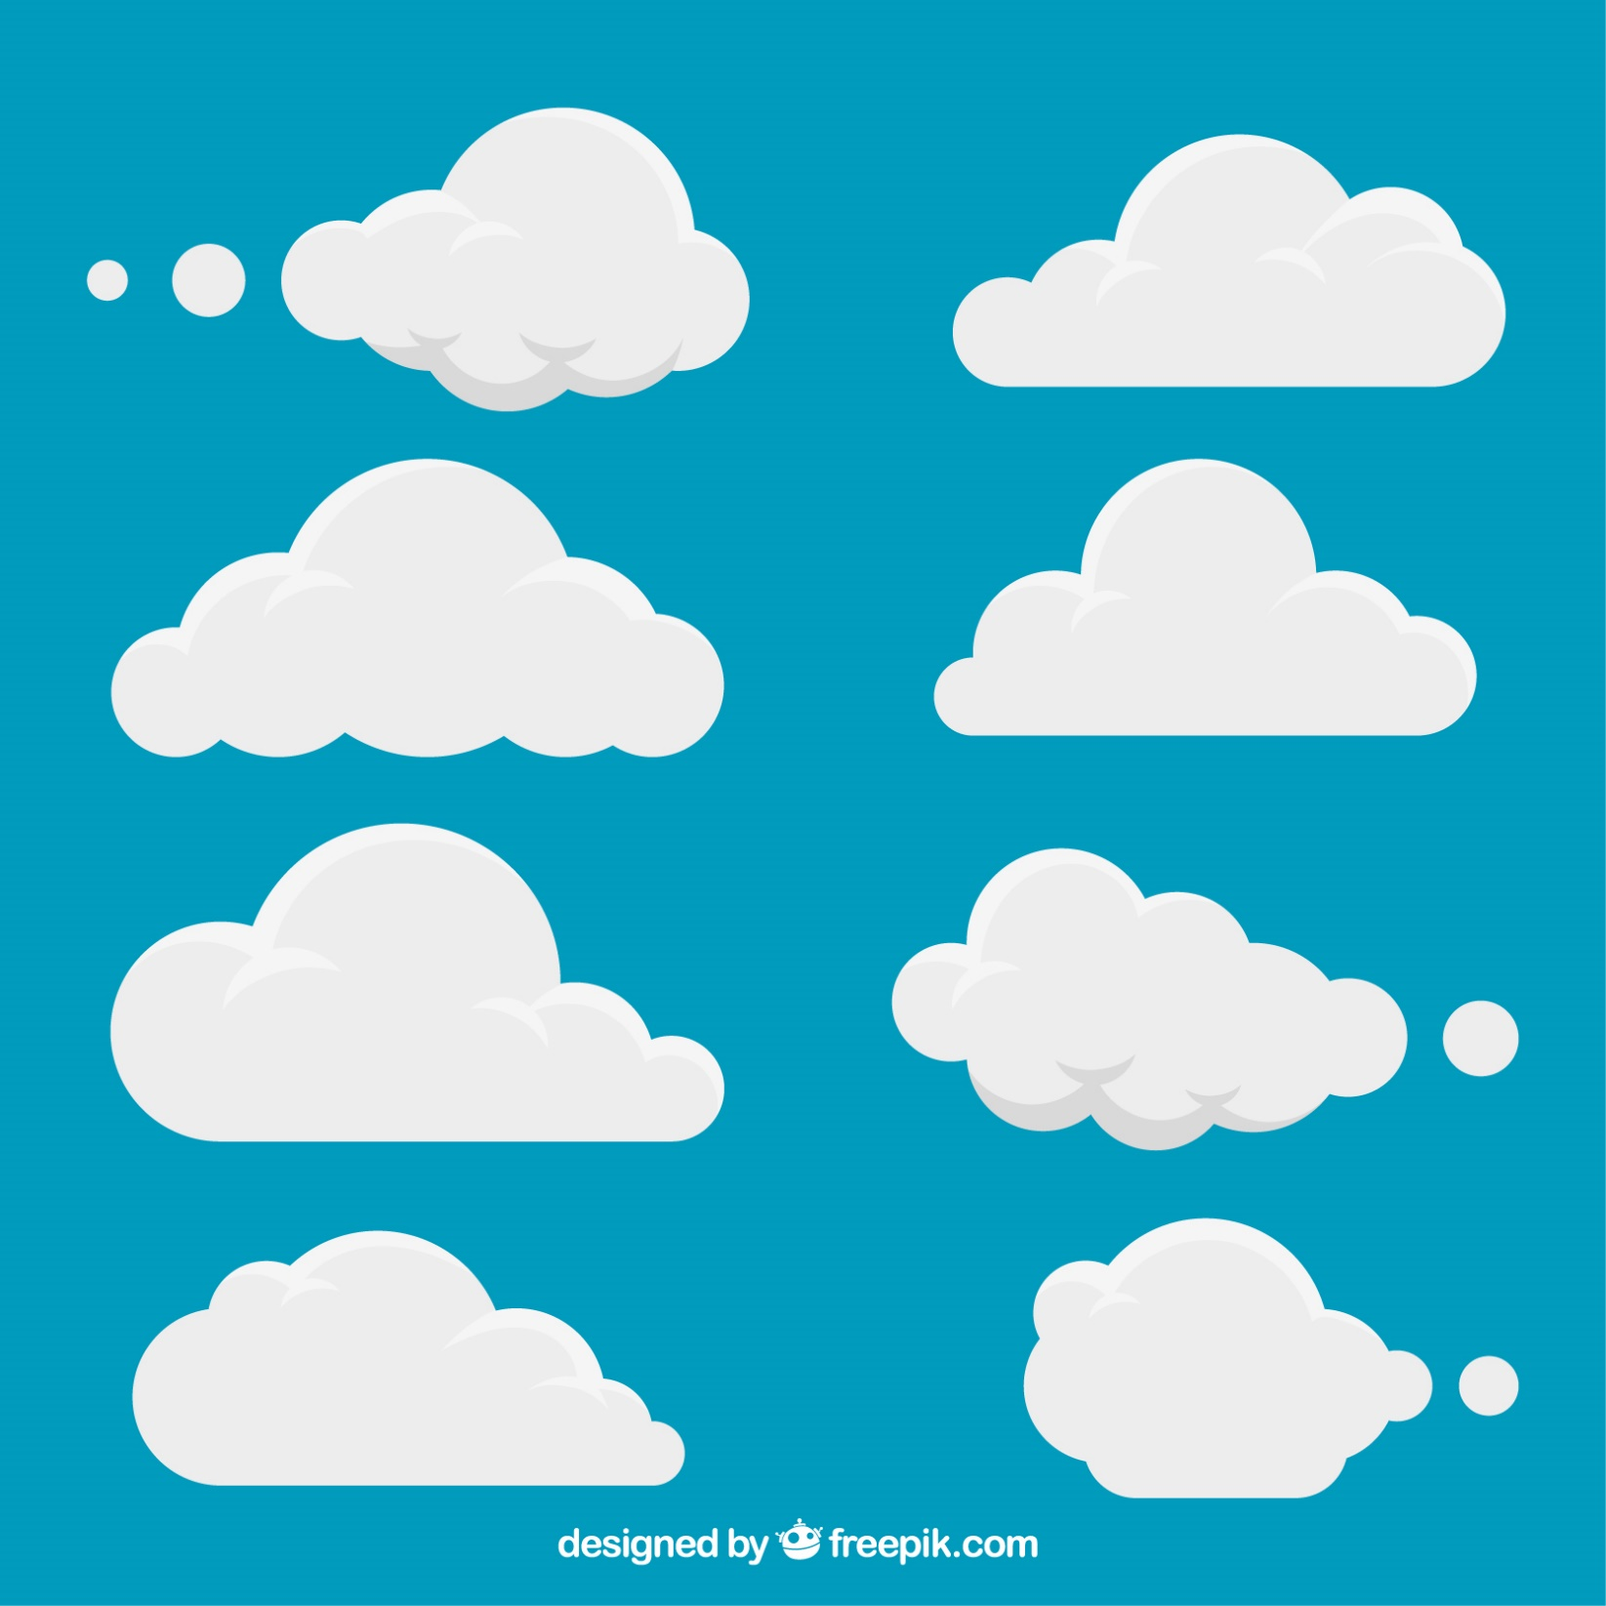
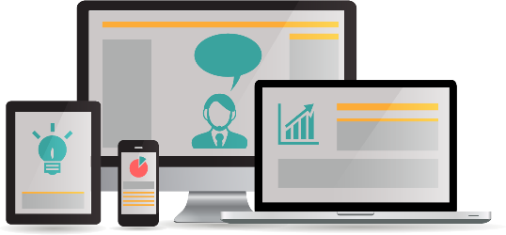
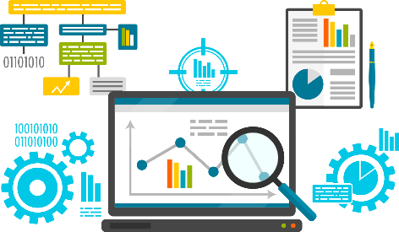

Solution
CLOUD
COMPUTING
Database & Security
Dynamically Scalable Servers
Remote Access to Devices
Fast Computation
Reduced Cost & Overhead

Slide 10
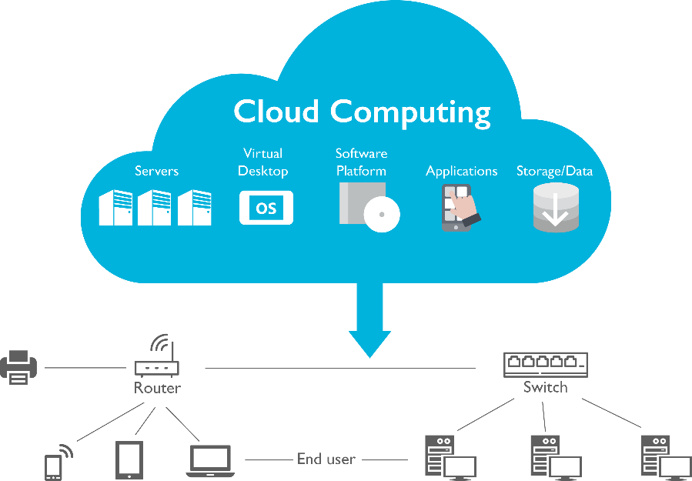
Cloud Computing
Cloud computing is the on-demand delivery of compute power, database storage, applications, and other IT resources through a cloud services platform via the internet with pay-as-you-go pricing
It is the use of remote servers on the internet to store, manage and process data rather than a local server or your personal computer

Slide 11
Cloud Services
On-Premise
Infrastructure as a Service (IaaS)
Platform as a Service (PaaS)
Software as a Service (SaaS)
Applications
Applications
Applications
Applications
Data
Data
Data
Data
Runtime
Runtime
Runtime
Runtime
Middleware
Middleware
Middleware
Middleware
O/S
O/S
O/S
O/S
Virtualization
Virtualization
Virtualization
Virtualization
Servers
Servers
Servers
Servers
Storage
Storage
Storage
Storage
Networking
Networking
Networking
Networking
Managed by Customer
Managed by Provider

Slide 12
Various Cloud Providers

Slide 13
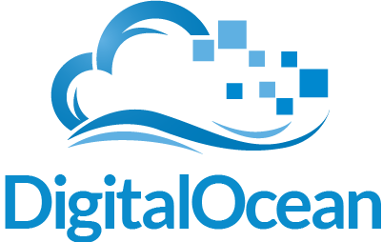
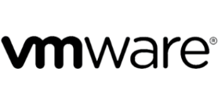

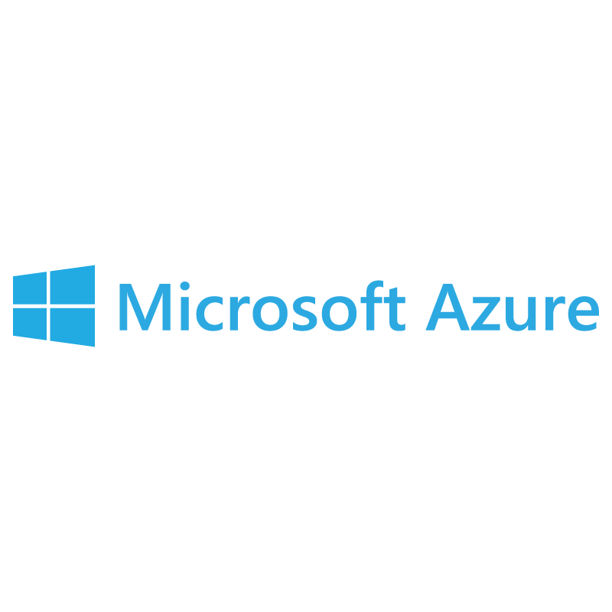
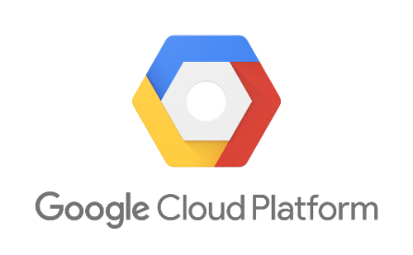
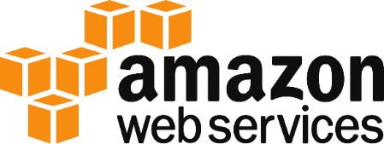
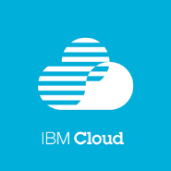


Cloud Providers

Slide 14
Why go for Google Cloud Platform?

Slide 15
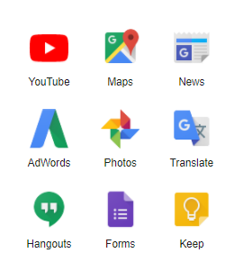
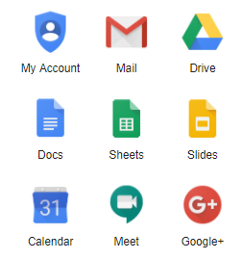
Why GCP?
Google Cloud Platform, is a suite of cloud computing services that runs on the same infrastructure that Google uses internally for its end-user products, such as Google Search, Gmail, Google Photos and YouTube
Notes:
Google Cloud Platform, is a suite of cloud computing services that runs on the same infrastructure that Google uses internally for its end-user products, such as Google Search, Gmail, Google Photos and YouTube

Slide 16
Run on Google’s Infrastructure
Build on the same infrastructure that allows Google to return billions of search results in milliseconds,
serve 6 billion hours of YouTube video per month and
provide storage for 425 million Gmail users.
Global Network
Redundancy
Innovative Infrastructure

Slide 17
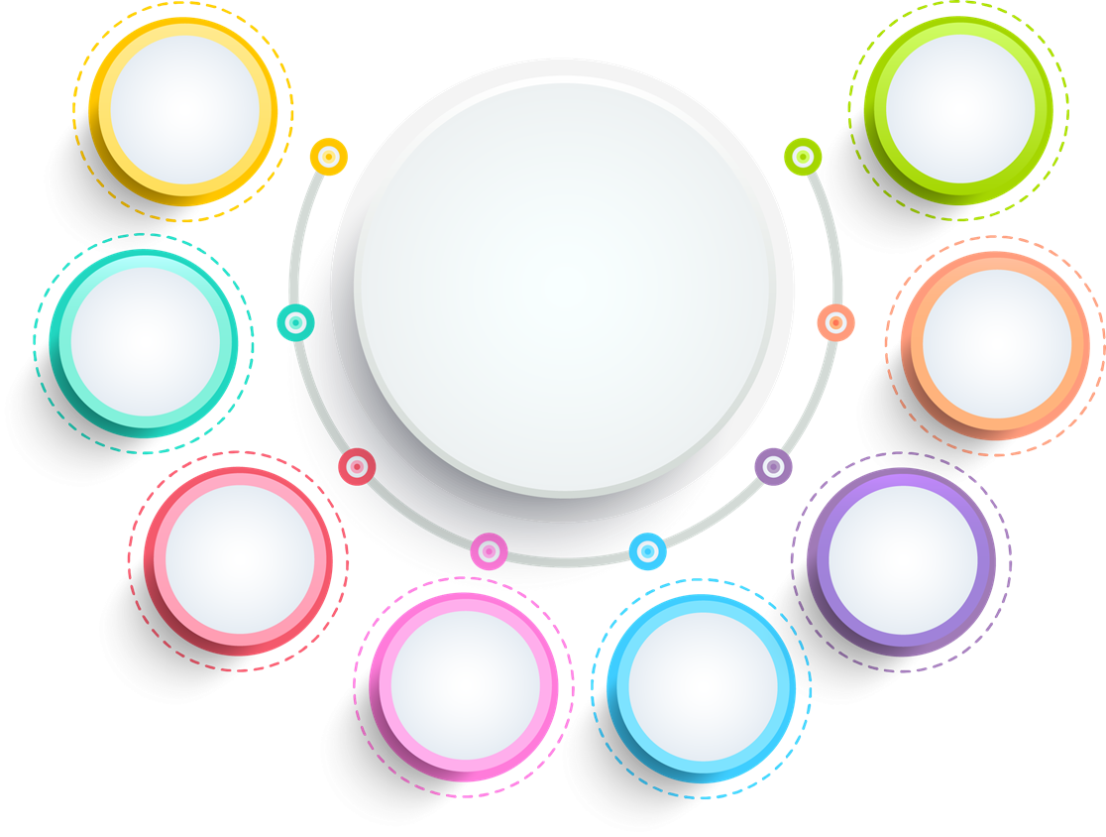

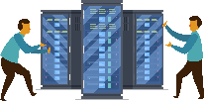






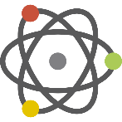
Why GCP?
Cost Effective
Serverless
Highly Scalable
Cloud AI
Custom Machine Types
Big Data Analytics
Internet of Things
API Platform and Ecosystem
Notes:
Cost Effective : Pay per use
Scalability : Highly Scalable (Auto Scalability)
Customized: Custom Machine Types :
Big Data Analytics : Fully managed data warehousing, batch and stream processing, data exploration, Hadoop/Spark, and reliable messaging
API Platform and Ecosystem: Cross-cloud API platform enabling businesses to unlock the value of data, deliver modern applications, and power ecosystems.
Internet Of Things: Intelligent IoT platform that unlocks business insights from your global device network
Cloud AI: Fast, large scale and easy to use AI services. neural net-based ML service has better training performance andincreased accuracy compared to other large scale deep learning systems.
Serverless : No upfront provisioning - Just provide your code and data, and Google dynamically provisions resources as needed. No management of servers. Applications with rapid time-to-market and unpredictable scale requirements benefit the most from Serverless

Slide 18
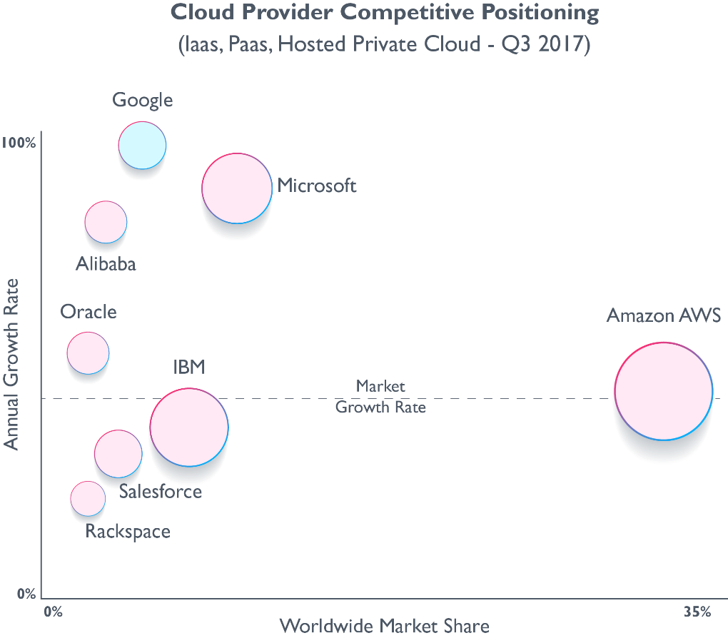
Why GCP?
Source: Synergy Resource Group

Slide 19
Why Google Cloud Platform?
Scale to millions of users
Applications hosted on Cloud Platform can automatically scale up to handle the most demanding workloads and scale down when traffic subsides. You pay only for what you use.
Scale-up:
Cloud Platform is designed to scale like Google’s own products, even when you experience a huge traffic spike. Managed services such as App Engine or Cloud Datastore give you auto-scaling that enables your application to grow with your users.
Scale-down:
Just as Cloud Platform allows you to scale-up, managed services also scale down. You don’t pay for computing resources that you don’t need.

Slide 20
Why Google Cloud Platform?
Focus on your product
Rapidly develop, deploy and iterate your applications without worrying about system administration. Google manages your application, database and storage servers so you don’t have to.
Managed services
Developer Tools and SDKs
Console and Administration

Slide 21
What is Google Cloud Platform?

Slide 22
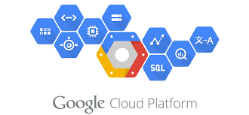
What is GCP?
Google Cloud Platform, is a suite of cloud computing services and management tools offered by Google
Alongside a set of management tools, it provides a series of modular cloud services including computing, data storage, data analytics and machine learning

Slide 23
GCP Regions and Zones

Slide 24
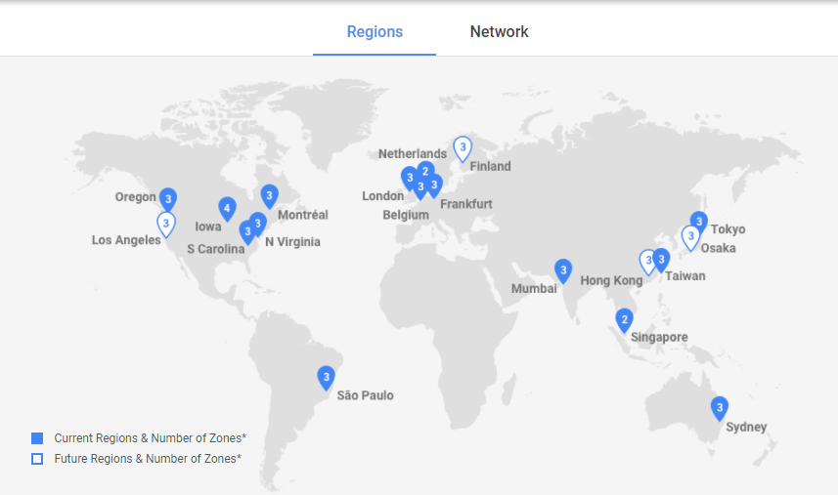
GCP Regions and Zones(2024)

Slide 25
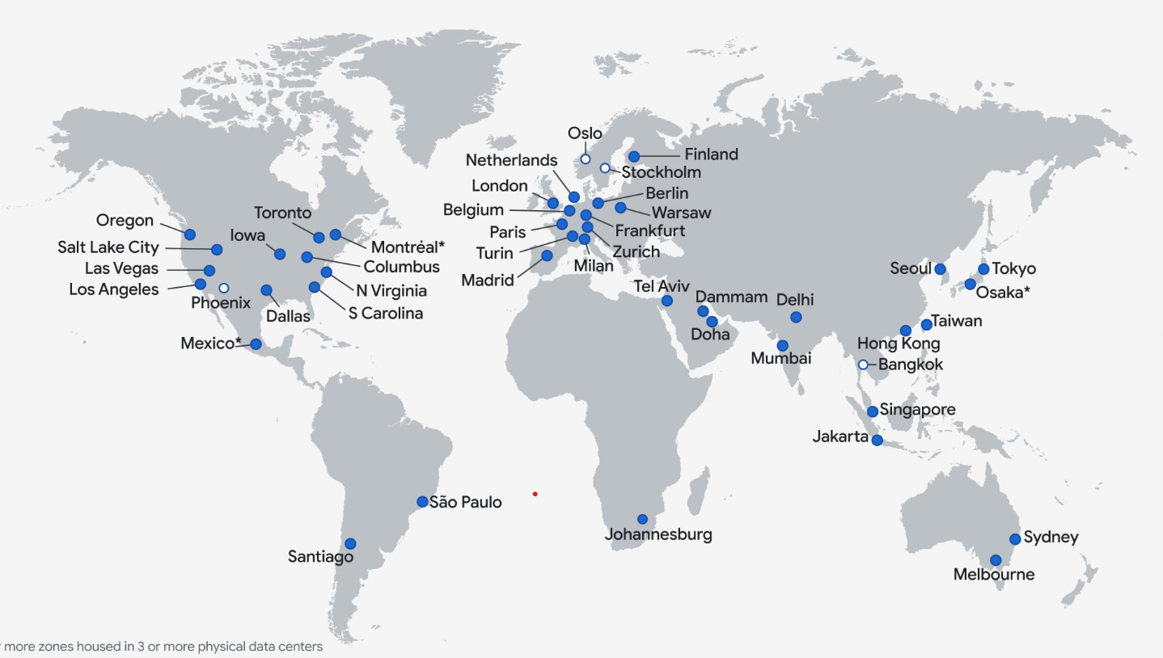
GCP Regions and Zones(2025)

Slide 26
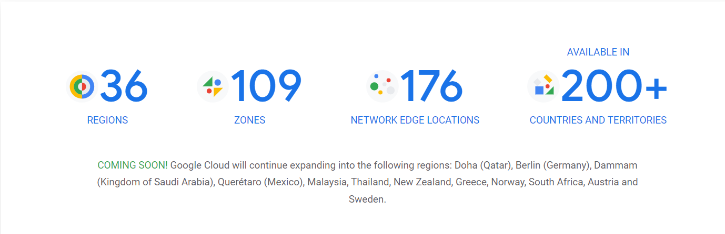
Google Cloud Regions & Zones(2024)

Slide 27
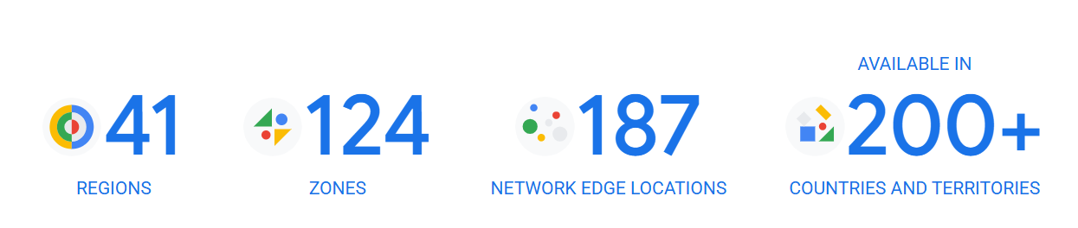
Google Cloud Regions & Zones(2025)

Slide 28
Google Cloud Regions & Zones
Compute Engine resources are hosted in multiple locations worldwide. These locations are composed of regions and zones.

Slide 29
Regions
A region is a specific geographical location where you can host your resources.
Regions are independent geographic areas that consist of zones.
A region consists of three or more zones housed in three or more physical data centers.

Slide 30
Regions
For eg-
The regions Mexico, Osaka, and Montreal have three zones housed in one or two physical data centers. These regions are in the process of expanding to at least three physical data centers.

Slide 31
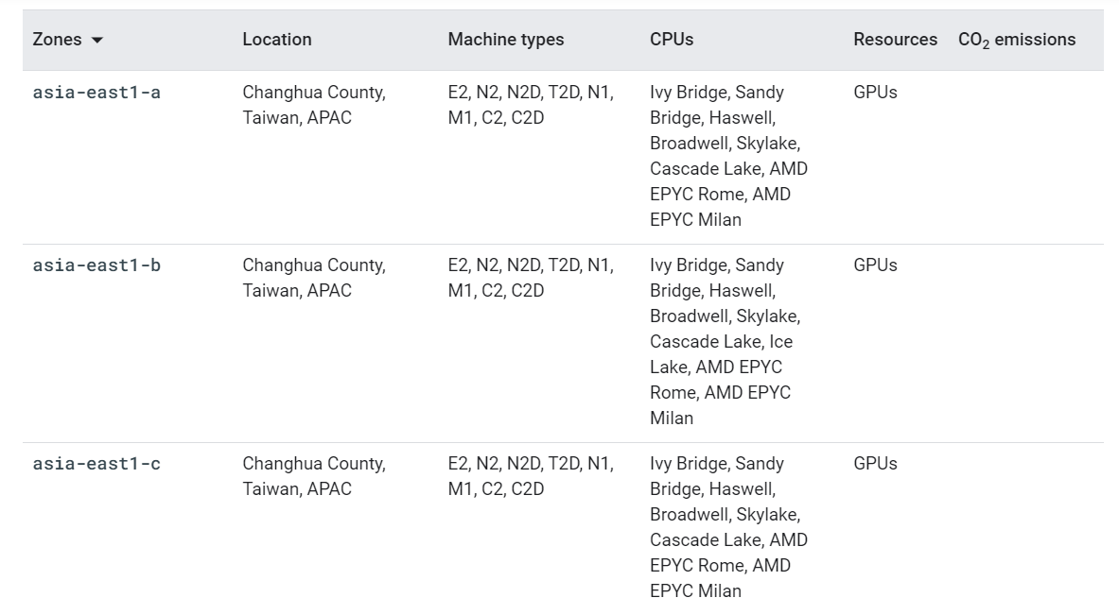
Google Cloud Regions & Zones
For example, the us-west1 region denotes a region on the west coast of the United States that has three zones: us-west1-a, us-west1-b, and us-west1-c.

Slide 32
Zones
A zone is a deployment area for Google Cloud resources within a region.
Zones should be considered a single failure domain within a region.
To deploy fault-tolerant applications with high availability and help protect against unexpected failures, deploy your applications across multiple zones in a region.

Slide 33
Zonal Resources
Zonal resources operate within a single zone.
Eg- Compute Engine virtual machine (VM) instance that resides within a specific zone.
Zonal outages can affect some or all of the resources in that zone.

Slide 34
Regional resources
Regional resources can be used by any resource in that region, regardless of zone, while zonal resources can only be used by other resources in the same zone.
For example, to attach a zonal persistent disk to an instance, both resources must be in the same zone.
Similarly, if you want to assign a region level static IP address to an instance, the instance must be in the same region as the static IP address, but can be from any zone.

Slide 35
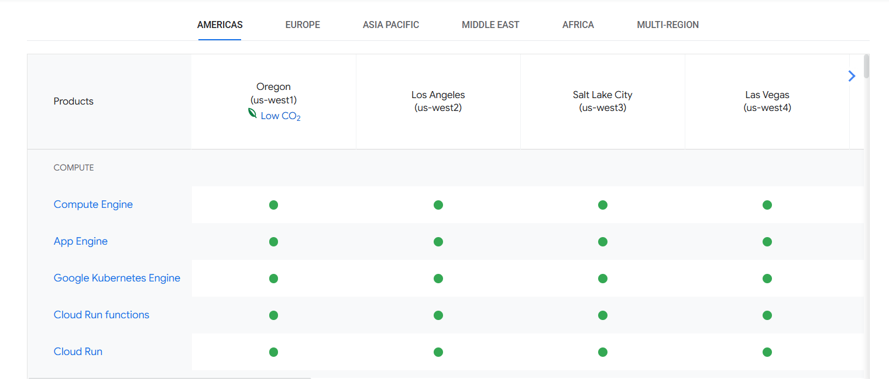
Products available by Location

Slide 36
Products available by Location
Global Locations - Regions & Zones | Google Cloud

Slide 37
Creating account on GCP

Slide 38
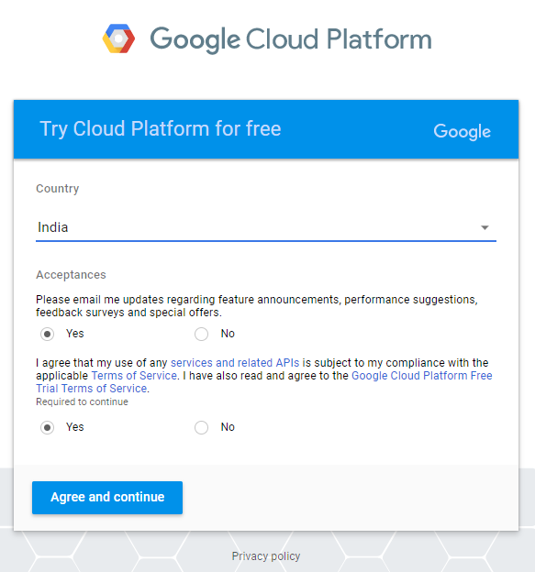
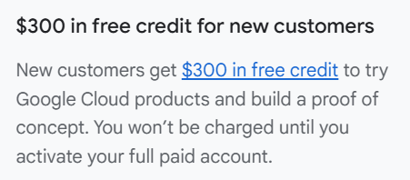
Creating Free Account
$300 in free credit
Try Google Cloud with $300 in credit to spend over the next 90 days
Signup for GCP

Slide 39
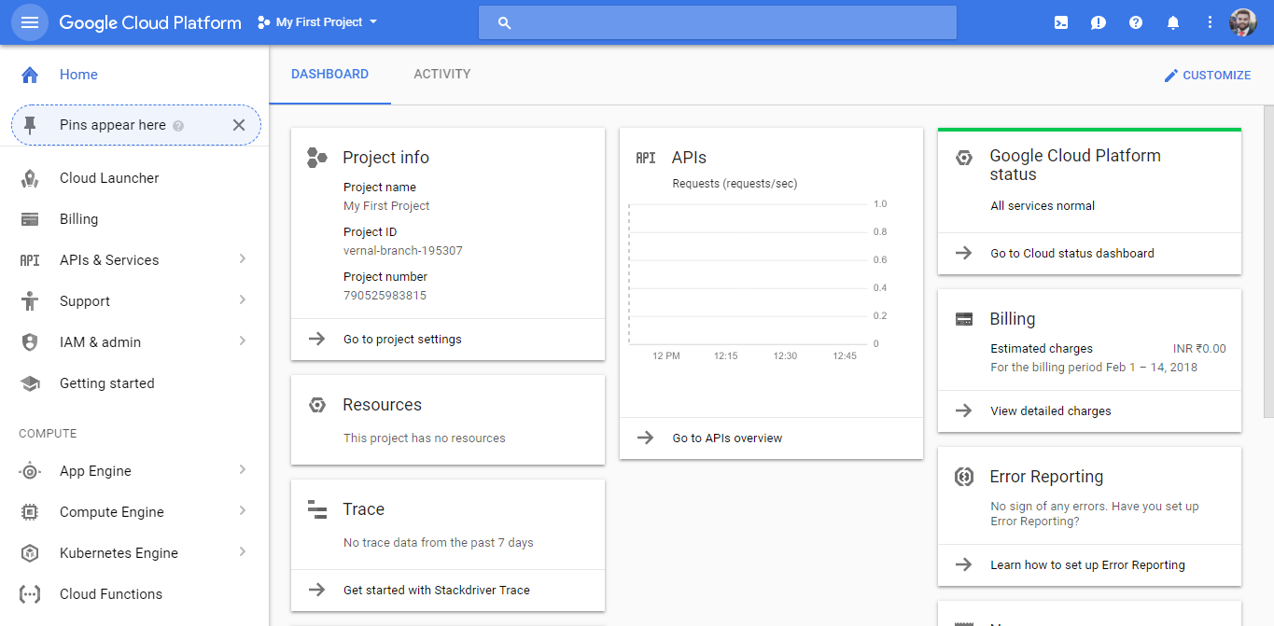
GCP Home
Notes:
All GCP services are associated with Project
By default a project is created when you Sign Up
Project Identity:
Name
Number
ID
Using Project, you can :
Enable Billing
Track resource usage
Manage permissions
Enable different services
Access APIs

Slide 40
GCP Services in Depth

Slide 41
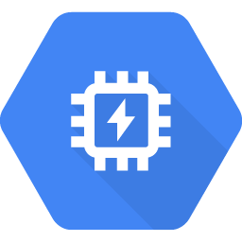
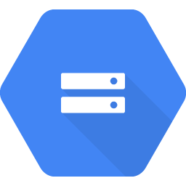
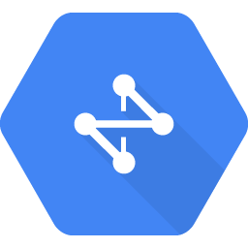
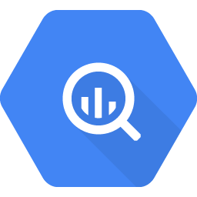
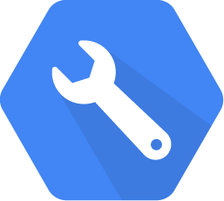
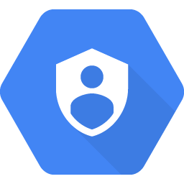
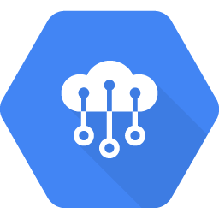
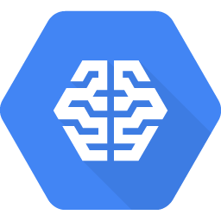
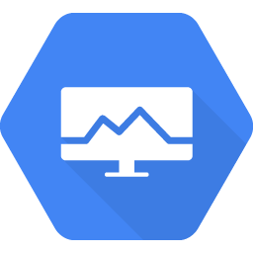
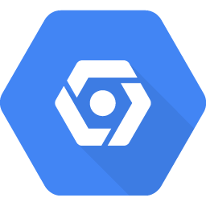
Google Cloud Platform Services
Compute
Storage & Database
Networking
Big Data
Developer Tools
Identity & Security
Internet of Things
Cloud AI
Management Tools
Data Transfer

Slide 42
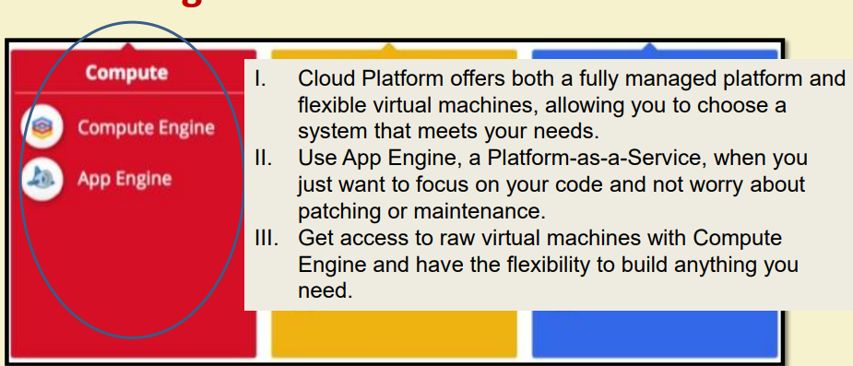
Google Cloud Platform Services

Slide 43
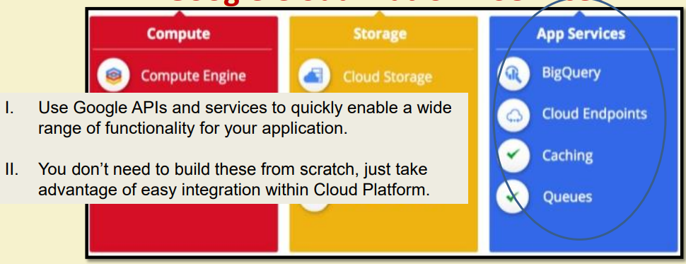
Google Cloud Platform Services

Slide 44
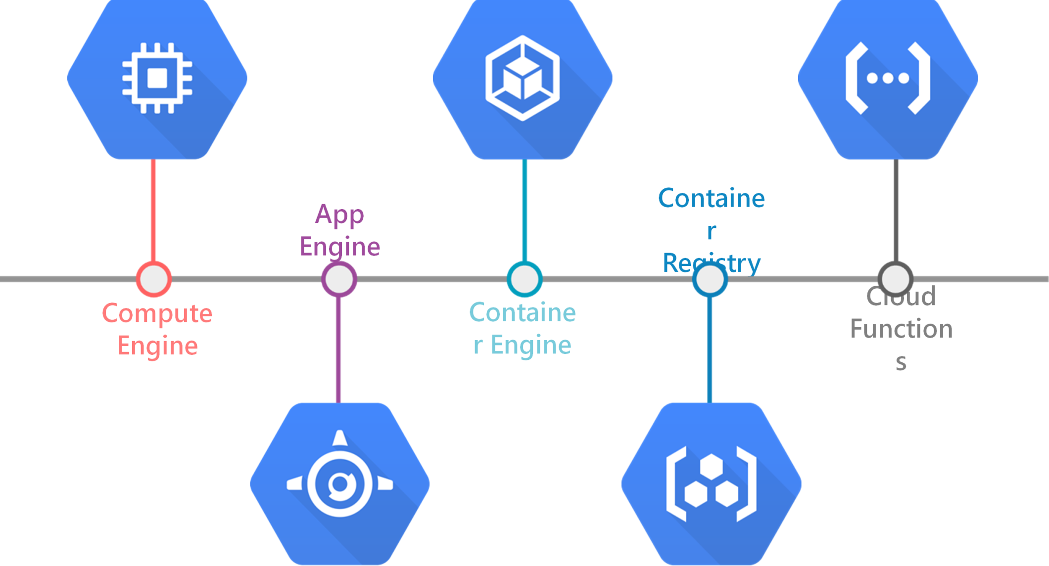
Compute
Notes:
From global, load-balanced, resilient services to flexible single-instance VMs, we provide a scalable range of computing options you can tailor to match your needs. Google Compute Engine provides highly customizable virtual machines with best-of-breed features,

Slide 45
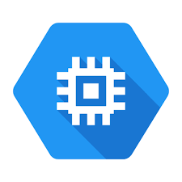
Google Cloud Platform Services
Compute Engine
Secure and customizable compute service that lets you create and run virtual machines on Google’s infrastructure.
Virtual machines for any workload
Easily create and run online VMs on high-performance, reliable cloud infrastructure.

Slide 46

Google Cloud Platform Services
Compute Engine
New users get $300 in free trial credits to use within 90 days.
The Compute Engine free tier gives you one e2-micro VM instance, up to 30 GB storage, and up to 1 GB of outbound data transfers per month, not charged against your credits.

Slide 47





Networking
Cloud Virtual Network
Cloud Load Balancing
Cloud CDN
Cloud Interconnect
Cloud DNS

Slide 48

Google Cloud Platform Services
Cloud VPC
Network of 41 regions, 128 zones in 200+ countries and territories with uptime of 99.99%
Use a single VPC to span multiple regions without communicating across the public internet

Slide 49
Google Cloud Platform Services
Cloud VPC
Global virtual network that spans all regions.
Single VPC for an entire organization, isolated within projects.
Increase IP space with no downtime.
New customers get $300 in free credits to spend on VPC.

Slide 50
Google Cloud Platform Services
Cloud CDN
Content Delivery Network
Uses Google's global edge network to serve content closer to users, which accelerates your websites and applications.
Fast, reliable web and video content delivery with global scale and reach.
New customers get $300 in free credits to spend on Cloud CDN.

Slide 51
What is a CDN?
A content delivery network (CDN) is a network of interconnected servers that speeds up webpage loading for data-heavy applications.
CDN can stand for content delivery network or content distribution network.
https://aws.amazon.com/what-is/cdn/

Slide 52
What is a CDN?
When a user visits a website, data from that website's server has to travel across the internet to reach the user's computer. If the user is located far from that server, it will take a long time to load a large file, such as a video or website image.
Instead, the website content is stored on CDN servers geographically closer to the users and reaches their computers much faster.
https://aws.amazon.com/what-is/cdn/

Slide 53
Why is a CDN important?
The primary purpose of a content delivery network (CDN) is to reduce latency, or reduce the delay in communication created by a network's design.
Because of the global and complex nature of the internet, communication traffic between websites (servers) and their users (clients) has to move over large physical distances.
The communication is also two-way, with requests going from the client to the server and responses coming back.
https://aws.amazon.com/what-is/cdn/

Slide 54
Why is a CDN important?
A CDN improves efficiency by introducing intermediary servers between the client and the website server.
These CDN servers manage some of the client-server communications. They decrease web traffic to the web server, reduce bandwidth consumption, and improve the user experience of your applications.
https://aws.amazon.com/what-is/cdn/

Slide 55
CDN?
You could think of a CDN like an ATM.
Having a cash machine on practically every corner makes it fast and efficient to get money. There’s no wait time in long bank lines, and the ATMs are placed in many convenient locations for immediate access.
https://www.akamai.com/our-thinking/cdn/what-is-a-cdn

Slide 56






Storage and Databases
Cloud Bigtable
Cloud SQL
Cloud Storage
Cloud Datastore
Persistent Disk

Slide 57

Google Cloud Platform Services
Cloud Storage
Object storage for companies of all sizes
Cloud Storage is a managed service for storing unstructured data. Store any amount of data and retrieve it as often as you like.
To use Cloud Storage, you’ll first create a bucket, a basic container that holds your data in Cloud Storage. You’ll then upload objects into that bucket—where you can download, share, and manage objects.

Slide 58
Google Cloud Platform Services
Cloud Storage
Cloud Storage is a service for storing your objects in Google Cloud. An object is an immutable piece of data consisting of a file of any format.

Slide 59

Google Cloud Platform Services
Cloud Storage
You store objects in containers called buckets. All buckets are associated with a project, and you can group your projects under an organization.
Each project, bucket, and object in Google Cloud is a resource in Google Cloud

Slide 60
Google Cloud Platform Services
Cloud Storage
After you create a project, you can create Cloud Storage buckets, upload objects to your buckets, and download objects from your buckets.
You can also grant permissions to make your data accessible to principals you specify, or - for certain use cases such as hosting a website - accessible to everyone on the public internet.

Slide 61
Google Cloud Platform Services
Cloud Storage
Organization: Your company, called Example Inc., creates a Google Cloud organization called exampleinc.org.
Project: Example Inc. is building several applications, and each one is associated with a project. Each project has its own set of Cloud Storage APIs, as well as other resources.

Slide 62
Google Cloud Platform Services
Cloud Storage
Bucket: Each project can contain multiple buckets, which are containers to store your objects. For example, you might create a photos bucket for all the image files your app generates and a separate videos bucket.
Object: An individual file, such as an image called puppy.png.

Slide 63
Storage Classes
A storage class is a piece of metadata that is used by every object.
The storage class set for an object affects the object's availability and pricing model.

Slide 64
Storage Classes
When you create a bucket, you can specify a default storage class for the bucket. When you add objects to the bucket, they inherit this storage class unless explicitly set otherwise.
If you don't specify a default storage class when you create a bucket, that bucket's default storage class is set to Standard storage.

Slide 65

Storage Classes

Slide 66

Google Cloud Platform Services
Cloud SQL
Fully managed relational database service for MySQL, PostgreSQL, and SQL Server with rich extension collections, configuration flags, and developer ecosystems.
New customers get $300 in free credits to spend on Cloud SQL. You won’t be charged until you upgrade.

Slide 67

Google Cloud Platform Services
Datastore
Datastore is a highly scalable NoSQL database for your web and mobile applications.
Datastore automatically handles sharding and replication, providing you with a highly available and durable database that scales automatically to handle your applications' load.
Datastore provides a myriad of capabilities such as ACID transactions, SQL-like queries, indexes, and much more.

Slide 68
What is Sharding?

Slide 69
What is Sharding?
The word “Shard” means “a small part of a whole“. Hence Sharding means dividing a larger part into smaller parts.
In DBMS, Sharding is a type of DataBase partitioning in which a large database is divided or partitioned into smaller data and different nodes.
These shards are not only smaller, but also faster and hence easily manageable.

Slide 70
Need for Sharding:
Consider a very large database whose sharding has not been done. For example, let’s take a DataBase of a college in which all the student’s records (present and past) in the whole college are maintained in a single database. So, it would contain a very very large number of data, say 100, 000 records.
Now when we need to find a student from this Database, each time around 100, 000 transactions have to be done to find the student, which is very costly.
Now consider the same college students records, divided into smaller data shards based on years. Now each data shard will have around 1000-5000 students records only.
So not only the database became much more manageable, but also the transaction cost each time also reduces by a huge factor, which is achieved by Sharding. Hence this is why Sharding is needed.

Slide 71
How does Sharding work?
In a sharded system, the data is partitioned into shards based on a predetermined criterion. For example, a sharding scheme may divide the data based on geographic location, user ID, or time period.
Once the data is partitioned, it is distributed across multiple servers or nodes. Each server or node is responsible for storing and processing a subset of the data.

Slide 72
How does Sharding work?
To query data from a sharded database, the system needs to know which shard contains the required data.
This is achieved using a shard key, which is a unique identifier that is used to map the data to its corresponding shard and then sends the query to the appropriate server or node.

Slide 73
Google Cloud Platform Services
Firestore
Firestore is the next generation of Datastore
Firestore is the newest version of Datastore and introduces several improvements over Datastore.
Existing Datastore users can access these improvements by creating a new Firestore in Datastore mode database instance. In the future, all existing Datastore databases will be automatically upgraded to Firestore in Datastore mode.

Slide 74

Google Cloud Platform Services
Cloud Bigtable
HBase-compatible, enterprise-grade NoSQL database service with single-digit millisecond latency, limitless scale, and 99.999% availability for large analytical and operational workloads.
New customers get $300 in free credits to spend on Bigtable
HBase is a column-oriented non-relational database management system that runs on top of Hadoop Distributed File System (HDFS)..

Slide 75

Google Cloud Platform Services
Persistent Disk
Reliable, high-performance block storage for virtual machine instances.
Enterprise scale, limitless flexibility, and competitive price for performance.
New customers get $300 in free credits to spend on Persistent Disk.

Slide 76






Big Data
BigQuery
Dataproc
Pub/Sub
Dataflow
Datalab
Genomics

Slide 77

Google Cloud Platform Services
Big Query
BigQuery is a fully managed, AI-ready data analytics platform that helps you maximize value from your data
BigQuery is a completely serverless and cost-effective enterprise data warehouse that works across clouds and scales with your data, with BI, machine learning and AI built in.
BigQuery's serverless architecture lets you use SQL queries to analyze your data.

Slide 78

Google Cloud Platform Services
Dataproc
Dataproc is a fully managed and highly scalable service for running Apache Hadoop, Apache Spark, Apache Flink, Presto, and 30+ open source tools and frameworks.
Run open source data analytics software at scale, with enterprise grade security
Fully managed and automated big data open source software

Slide 79

Google Cloud Platform Services
Dataflow
Dataflow is a managed service for executing a wide variety of data processing patterns.
Batch and streaming data processing using Dataflow,
Unified stream and batch data processing that's serverless, fast, and cost-effective.
New customers get $300 in free credits to spend on Dataflow.

Slide 80

Google Cloud Platform Services
Cloud Life Sciences^{BETA}
From Genomics to Life Sciences
Cloud Life Sciences enables the life sciences community to process biomedical data at scale.
Process, analyze, and annotate genomics and biomedical data at scale using containerized workflows.

Slide 81
Google Cloud Platform Services
Cloud Life Sciences^{BETA}
Cloud Life Sciences is a suite of services and tools for managing, processing, and transforming life sciences data. It also enables advanced insights and operational workflows using highly scalable and compliant infrastructure.
Cloud Life Sciences includes features such as the Cloud Life Sciences API, extract-transform-load (ETL) tools, and more.

Slide 82

Google Cloud Platform Services
Cloud Life Sciences^{BETA}

Slide 83






Machine Learning
Cloud Machine Learning
Speech API
Translation API
Vision API
Natural Language API
Jobs API

Slide 84



Identity & Security
Cloud Resource Manager
Cloud IAM
Cloud Security Scanner
Cloud Platform Security

Slide 85


Management and Developer Tools

